Slide 1
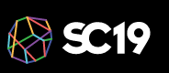
Buildtest: A Software Testing Framework with Module Operations for HPC systems
Shahzeb Siddiqui (Shahzeb.Siddiqui@3ds.com)
SIMULIA R&D Run Online Operations Senior Manager - Dassault Systemes
11/18/2019
GitHub: https://github.com/HPC-buildtest/buildtest-framework
Documentation: http://buildtest.rtfd.io

Slide 2








whoami
Duties: User Support Tickets, Scheduler Configuration, Software Installation, System Administration, User Training, Documentation
Interests: Containers, Scheduler Optimization & Job Analytics, Performance Tuning and System Benchmarking, Parallel Programming, DevOps, Configuration Management
M.S Computer Science at KAUST
B.S Computer Engineer at Penn State University
Github: https://github.com/shahzebsiddiqui
LinkedIn: https://www.linkedin.com/in/shahzebmsiddiqui/
Email: shahzebmsiddiqui@gmail.com

Slide 3
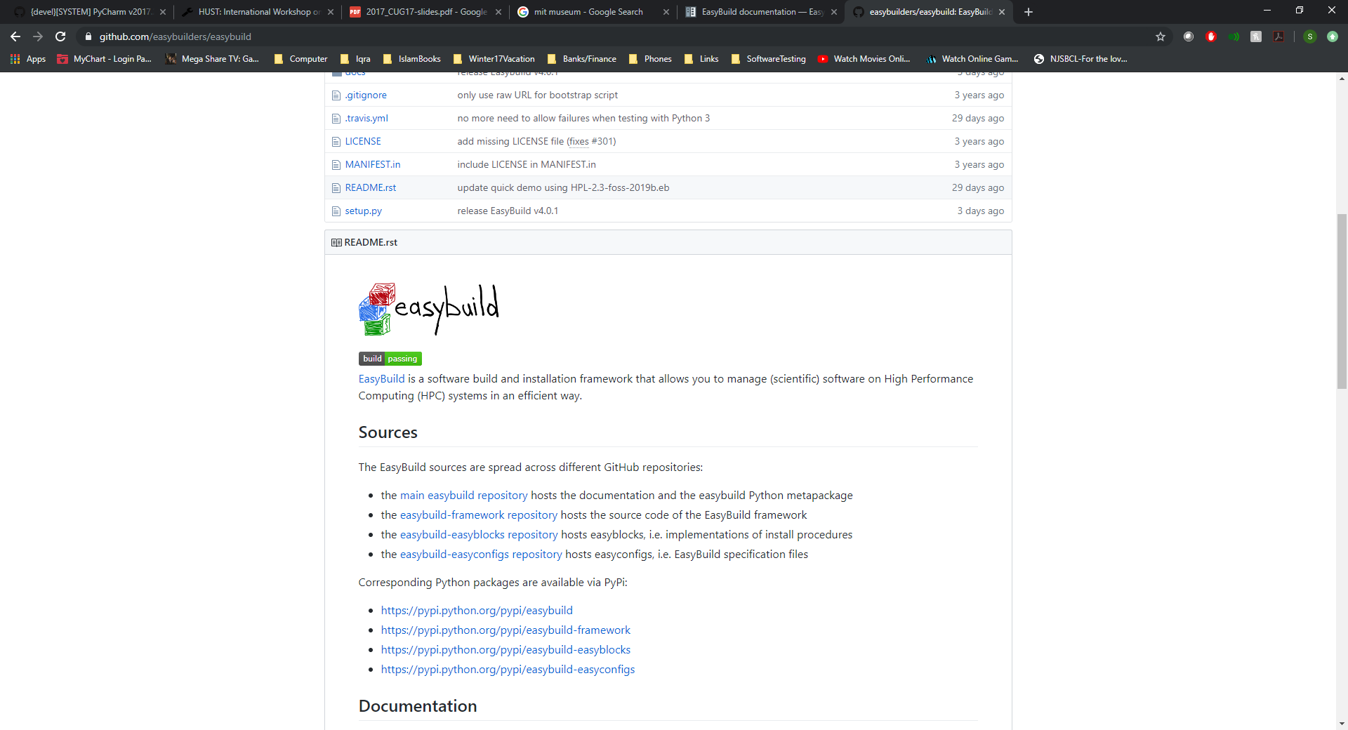
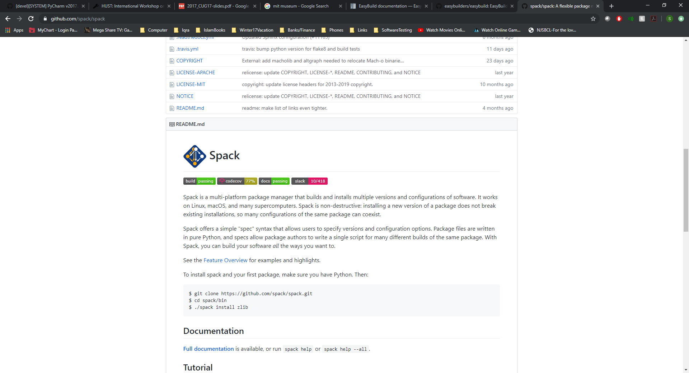
Background
HPC Software Stacks are growing at an astronomical rate with up to 1000+ software (open source, commercial), many sites have adopted tools like Easybuild or Spack to automate software stack build
HPC Support team will typically install the software and let user test the software
What happens where there is a software bug?
Who do you blame: User, Administrator, System, or Package Maintainer?
HPC Support Team lack the domain expertise to test the software and often too busy with operation support & engineering projects that software testing is often neglected

Slide 4
Motivation
Currently, there is little or no collaboration in HPC community in how to conduct software stack testing
This demands for concerted effort by HPC community to build an open-source community for software stack testing
We need to:
Build a framework to do automatic testing of installed software
Build a test repository for scientific software that is community driven and reusable
An automated test framework is a harness for automating test creation, but it requires community contribution to accumulate this repository on per-package basis

Slide 5
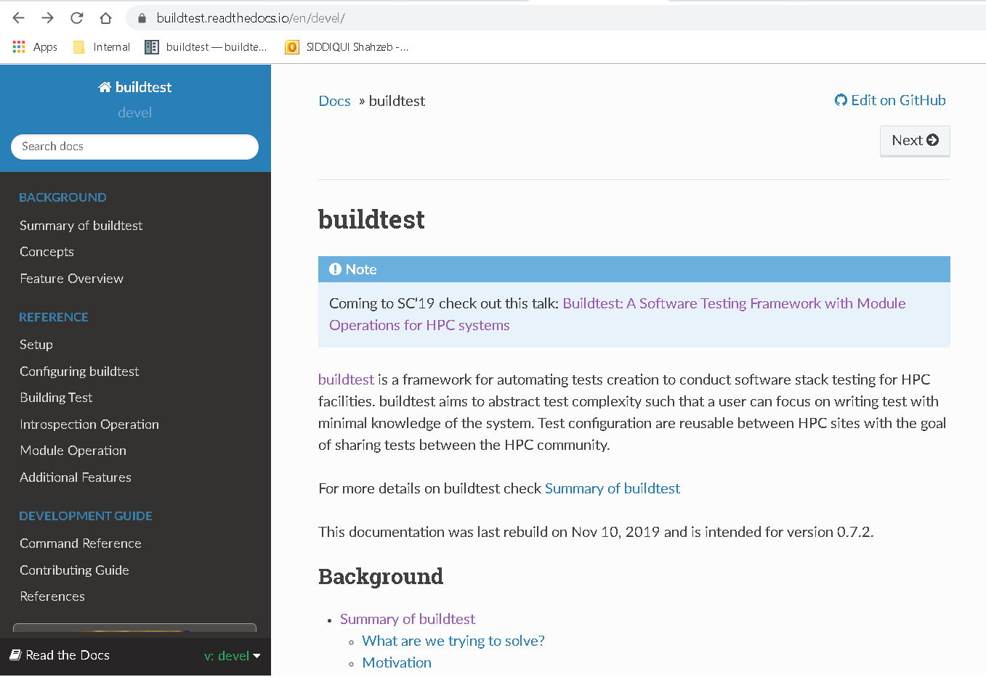
What is buildtest
Buildtest is a framework that:
Automates test script creation
Abstracts test complexity by using test configuration written in YAML
Allows Portable test configurations
Provides many software stack operations
Buildtest comes with a repository of test configuration and source files

Slide 6
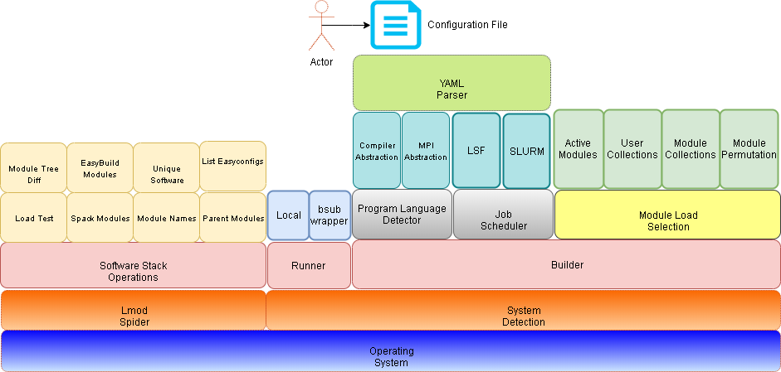
Buildtest Architecture

Slide 7
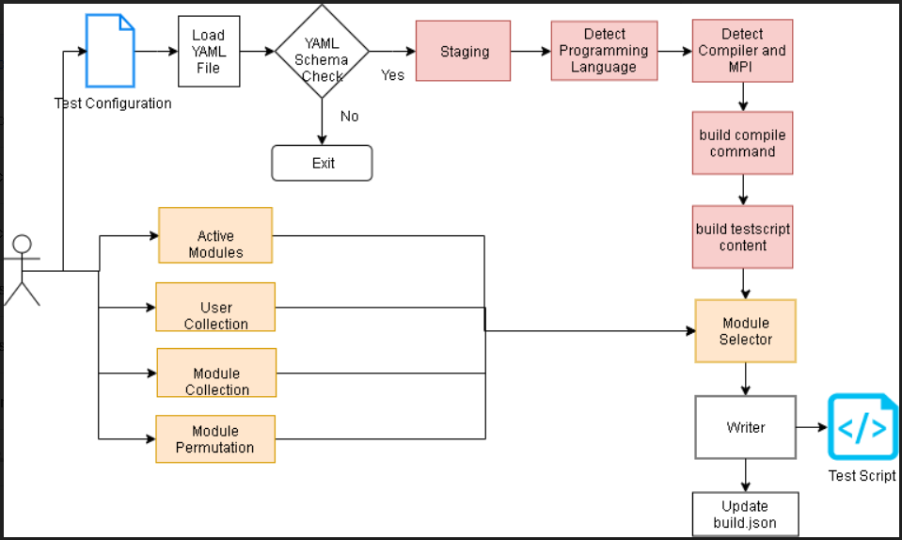
Build Pipeline

Slide 8
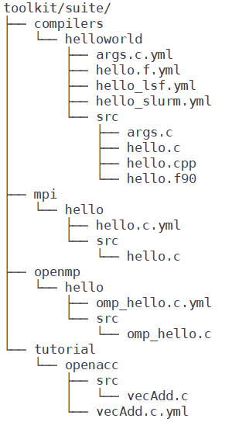
Building a Test
To build a test script just specify a test configuration to buildtest as follows: buildtest build –c <test-configuration>
The test configuration can be found under $BUILDTEST_ROOT/toolkit/suite
Name of test configuration is formulated by replacing file separator (/) by a dot (.) so compilers/hellworld/args.c.yml → compilers.helloworld.args.c.yml
Source code must be under src directory and test configuration must be named with extension .yml

Slide 9
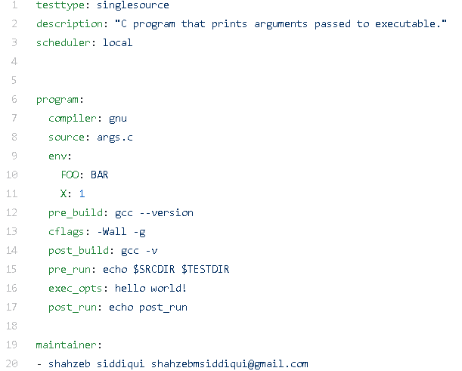
Test Configuration
Informs buildtest this is a Single Source Compilation. Implemented as a Python Class
Description of text. Limited to 80 chars
Run Test Locally
Start of Test Declaration
Specify Compiler Name
Source File to be compiled
Start of Environment Variable Declaration
Commands to run before and after compilation.
Passing flags to C compiler by setting CFLAGS variable
Commands to run before and after execution.
Passing Arguments to the Execution
List of Maintainers

Slide 10
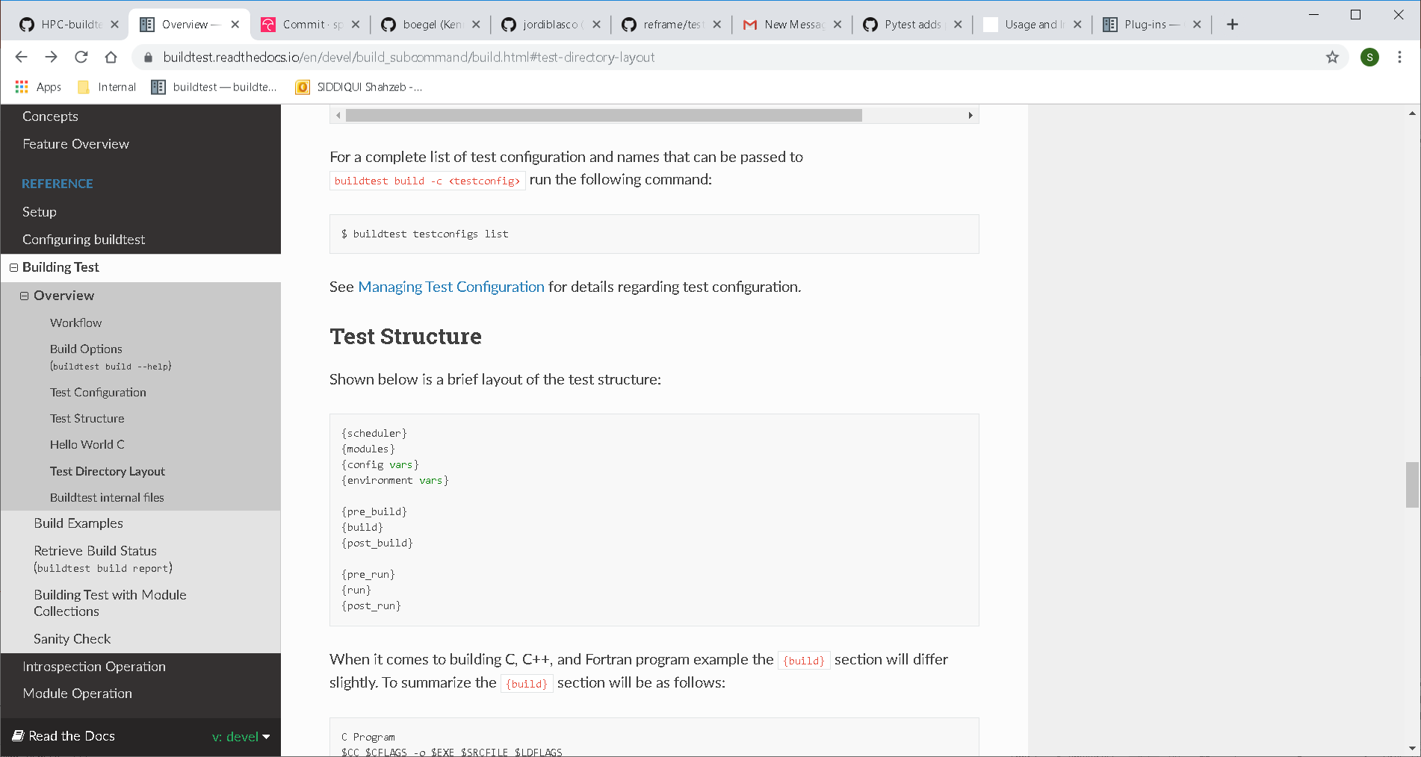
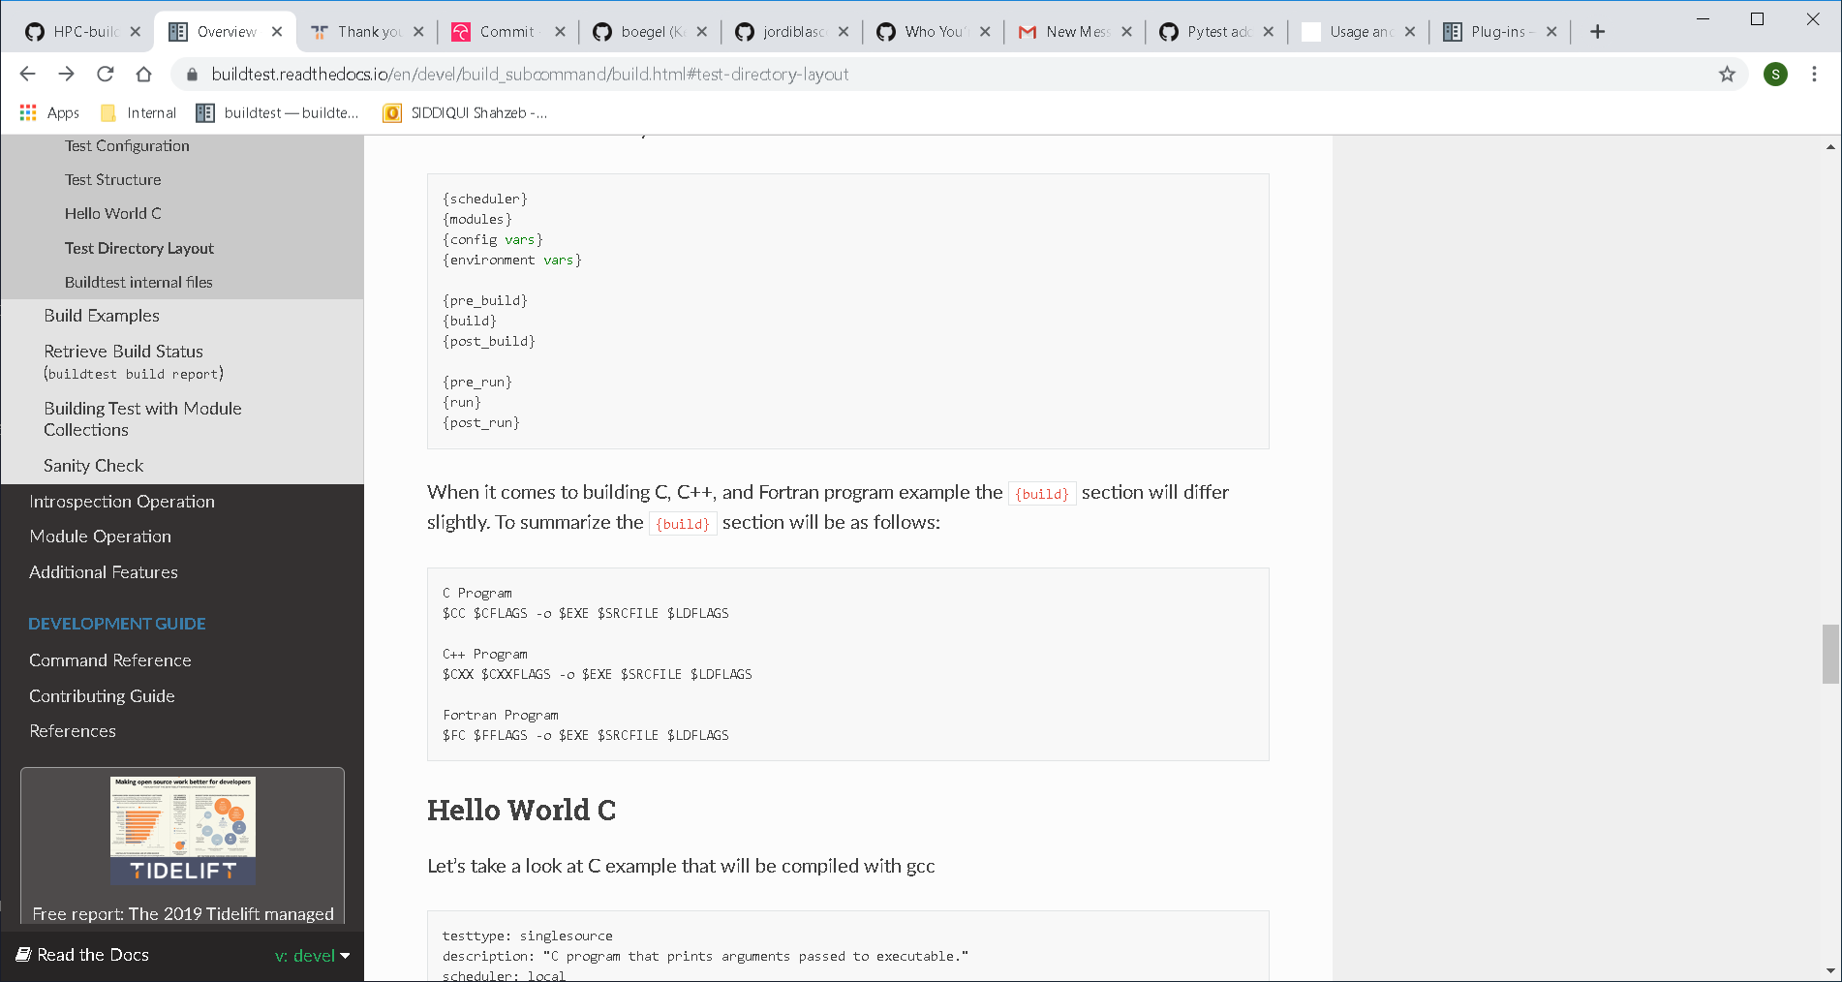
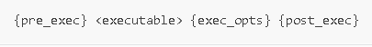
Test Configuration
For Single Source compilation (C, C++, Fortran, CUDA) and MPI code the general structure of the test will be as follows:
Buildtest will auto create the following sections: {config vars} {build} and {run}
{pre_build}, {post_build}, {pre_run}, {post_run} are sections where shell commands can be injected into test script
{module} section is used for loading modules that can be one of the following: active modules, user collection, buildtest module collection, or module permutation.
{scheduler} section will be generated only if scheduler: LSF or scheduler: SLURM is set in configuration file.

Slide 11
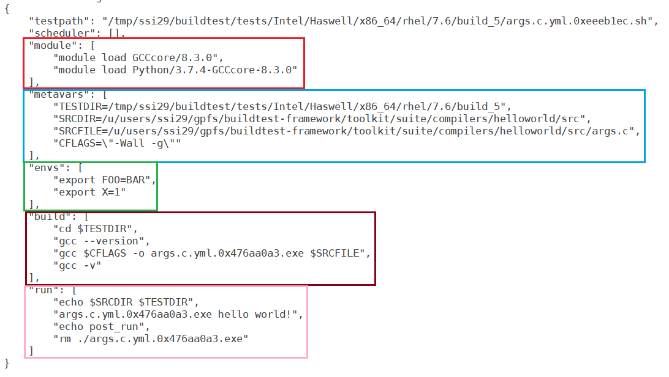
Test Configuration
Vendor
Arch
Platform
Operating System
OS Release
Build ID
BUILDTEST_TESTDIR=/tmp/ssi29/buildtest/tests
Auto Generated
Auto Generated
Auto Generated

Slide 12
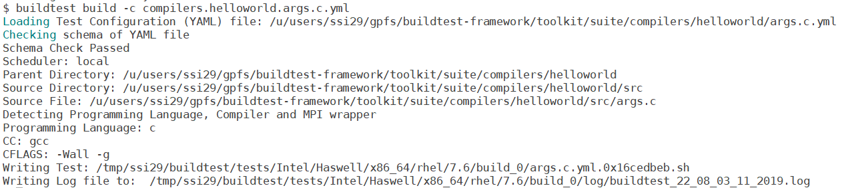
Example Build

Slide 13
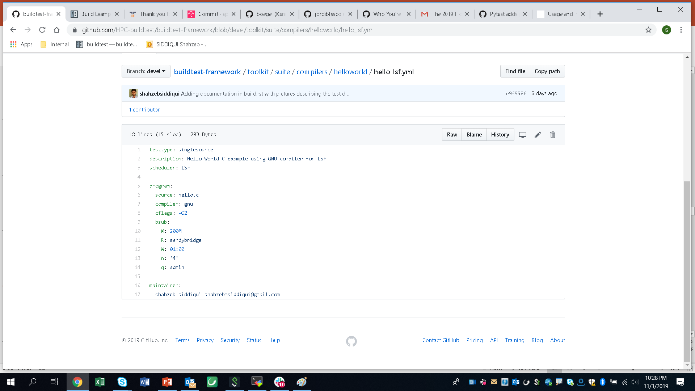
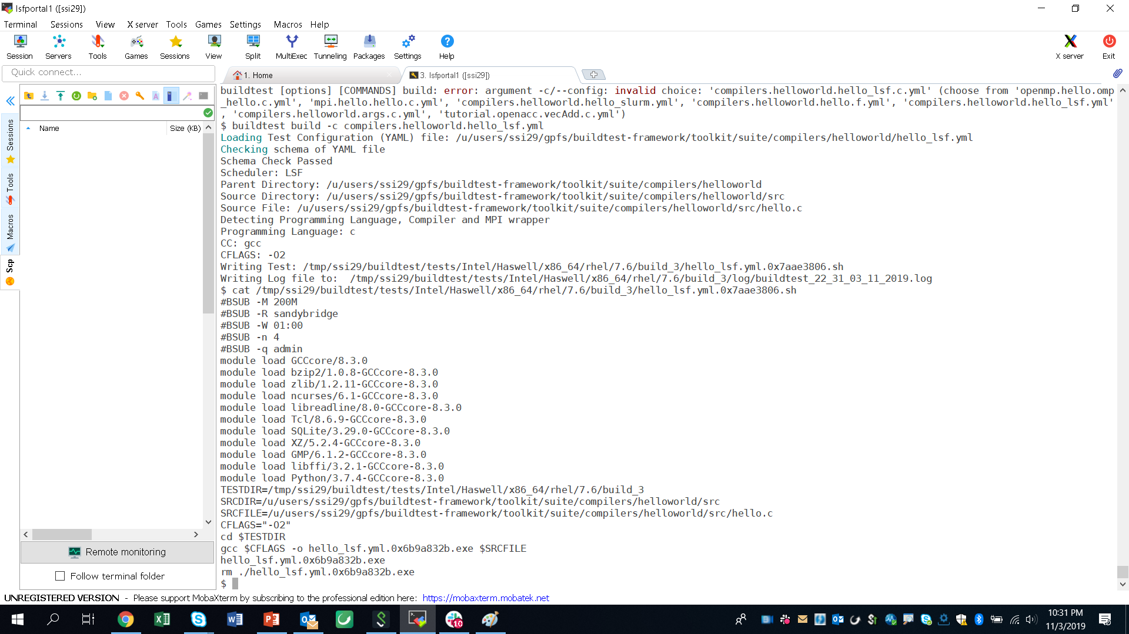
LSF Test

Slide 14
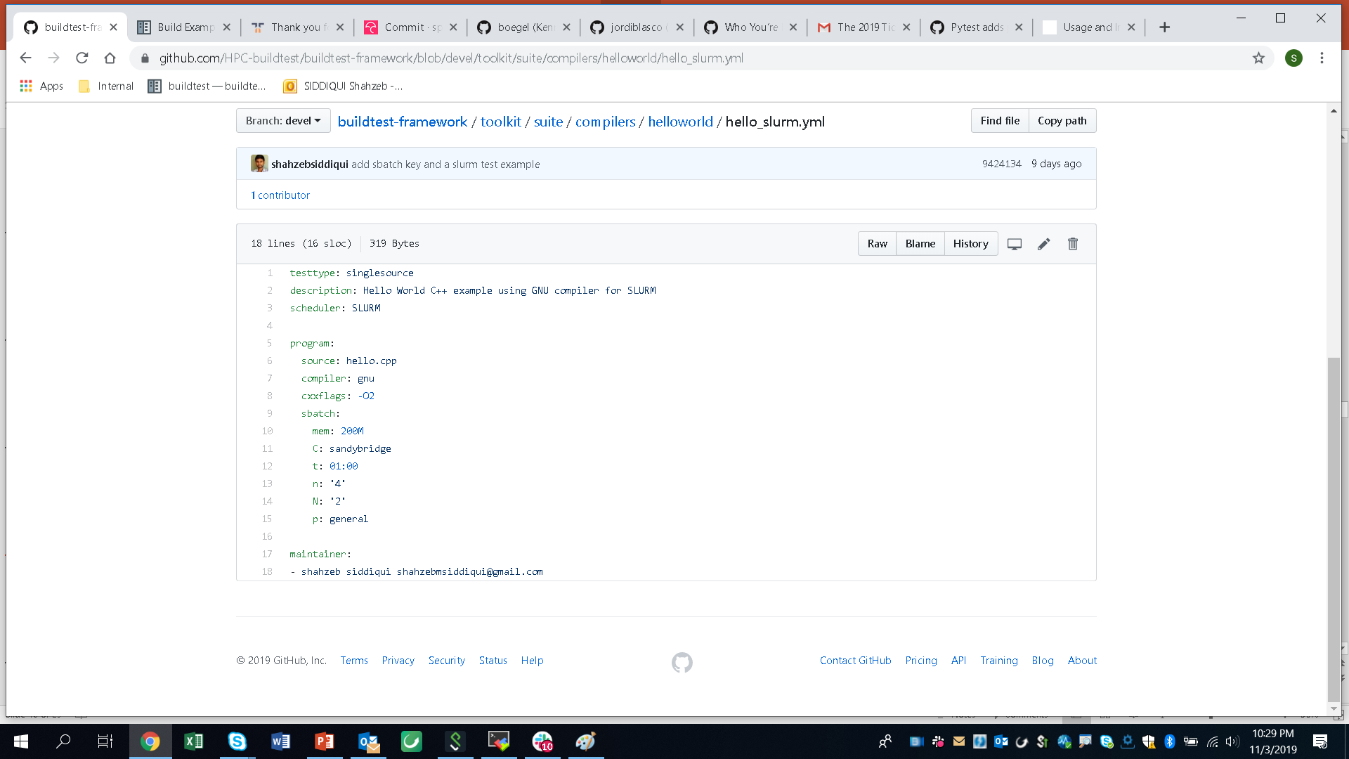
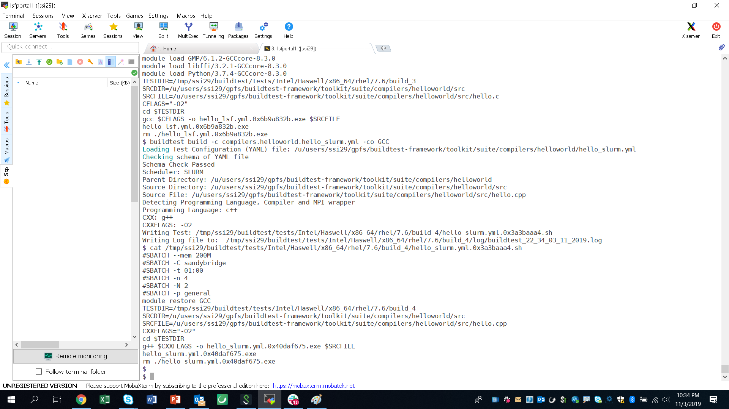
SLURM Test

Slide 15
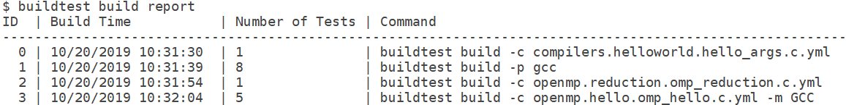
Build History
Buildtest keeps track of every build in a json file (build.json). The build ID that can be used to retrieve tests, logs, and run tests
To retrieve a report of all builds: buildtest build report
Retrieve Logs for build ID 3: buildtest build log 3
Retrieve test scripts for build ID 3: buildtest build tests 3
Run tests for build ID 3: buildtest build run 3

Slide 16
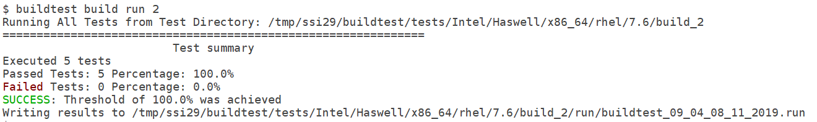
Running Test Locally
Running buildtest build run <ID> will run all testscripts that corresponds to the build ID.
Buildtest will write a .run file that contains output of all tests
A zero exit status will be a PASSED test and non-zero will be a FAILED test

Slide 17
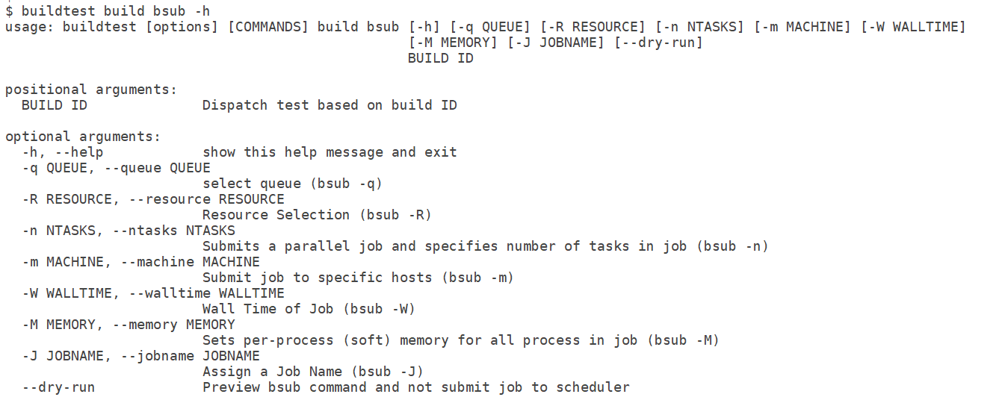
Submit Jobs via bsub (Experimental Feature)
Buildtest provides CLI to run any build ID via bsub wrapper regardless if you have specified any bsub parameters in the test configuration.
Currently, the following options are available for bsub

Slide 18
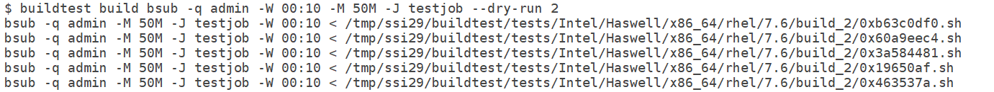
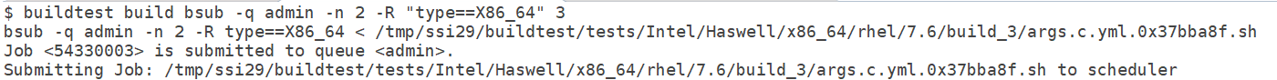
Submitting Jobs via bsub
The -–dry-run option will let you see the bsub command without actually running the command.
All bsub options are processed as string types in order for bsub command to handle complex commands

Slide 19
Integration with Spider
Buildtest solves the module load problem by parsing json content of the following command: spider –o spider-json $BUILDTEST_MODULEPATH
Buildtest leverages spider to load modules into test.
Spider is automatically updated when MODULEPATH changes!
In addition, spider has allowed buildtest to create new module utilities useful for Software Stack Administrators
For more details refer to the following links:
https://lmod.readthedocs.io/en/latest/136_spider.html
https://buildtest.readthedocs.io/en/devel/concepts.html

Slide 20
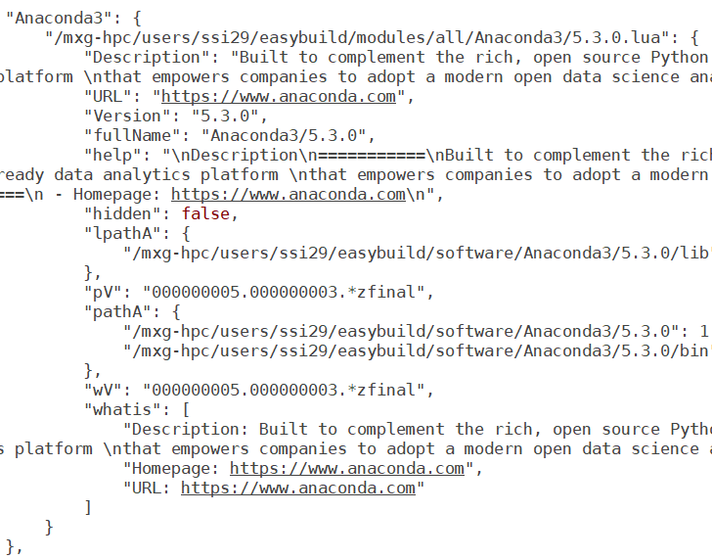
Spider Content

Slide 21
Software Stack Operations

Slide 22
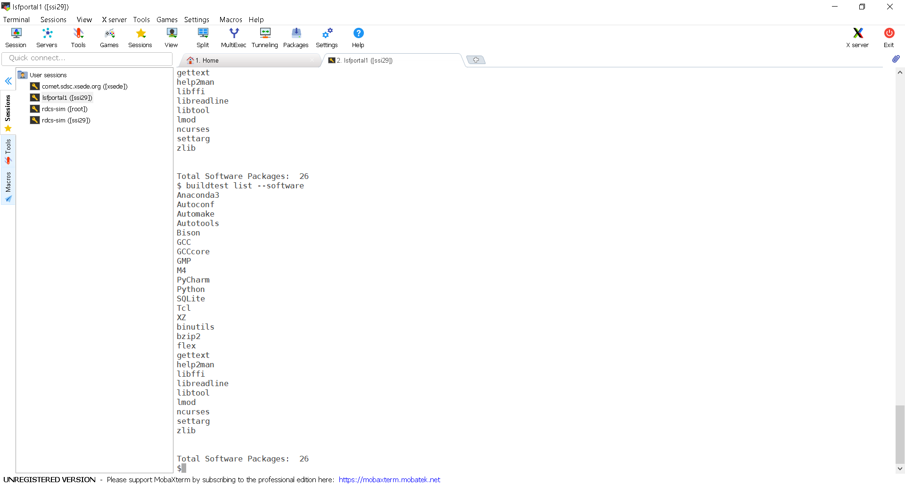
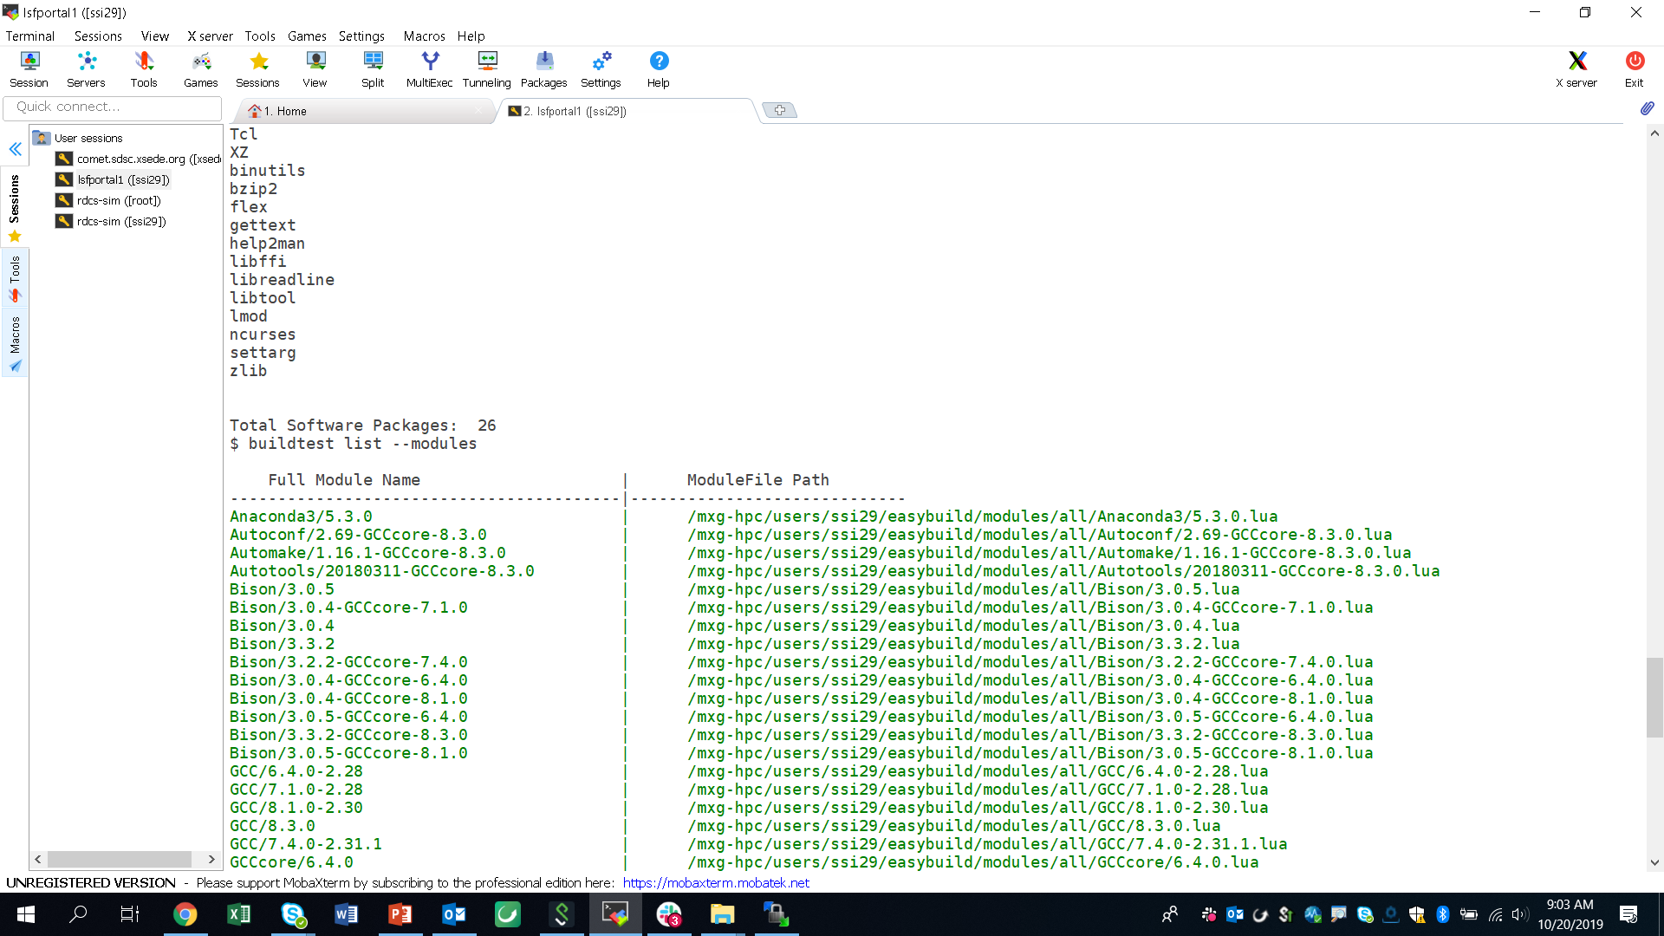
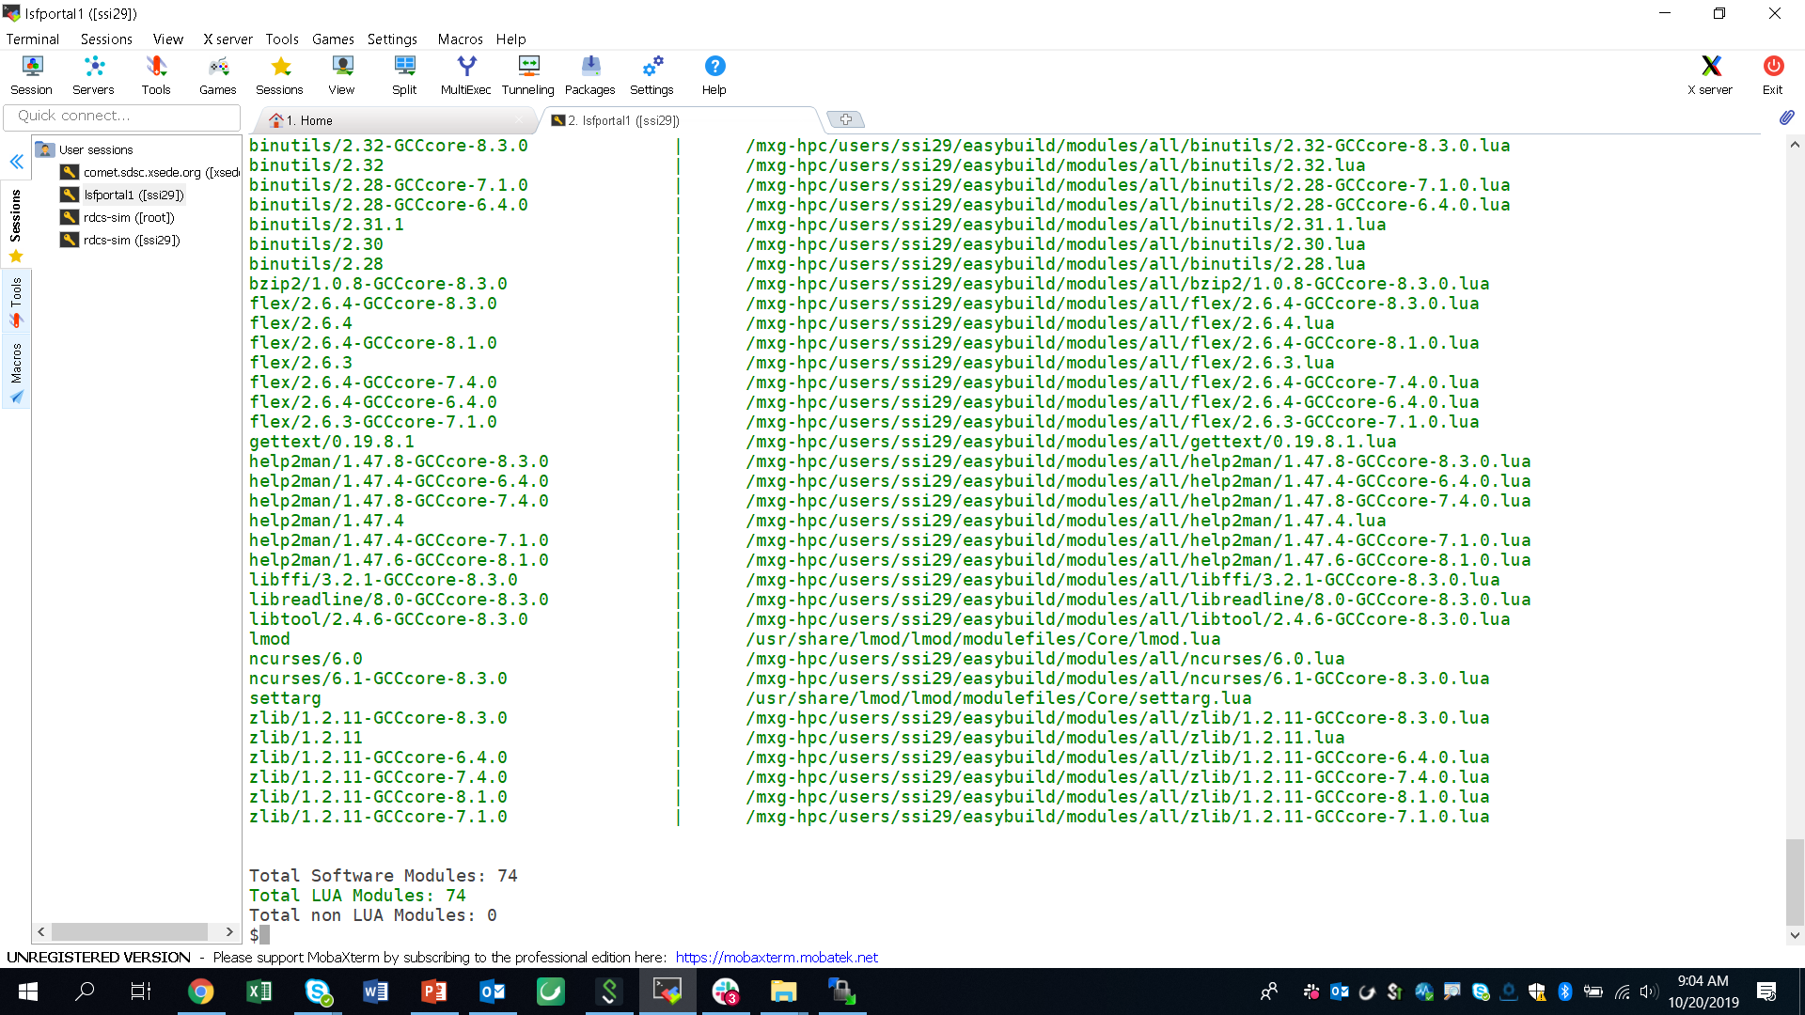
List of Installed Software and Modules
Problem: Retrieve a list of unique software and modules installed in the cluster
Use Case: Automatically keep an updated list of software as part of end-user documentation.

Slide 23
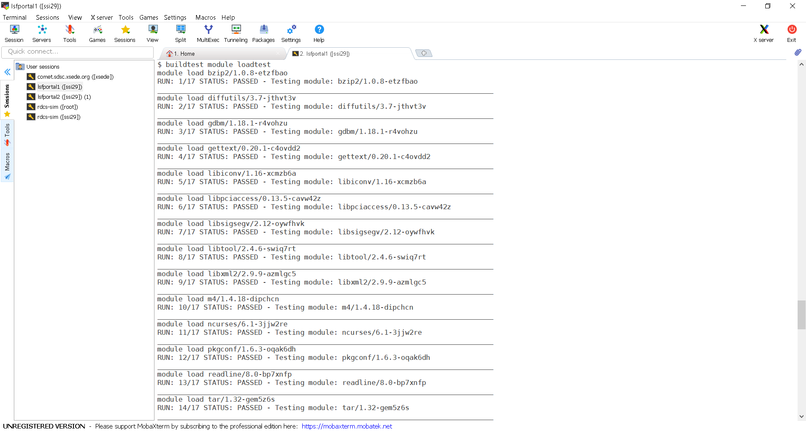
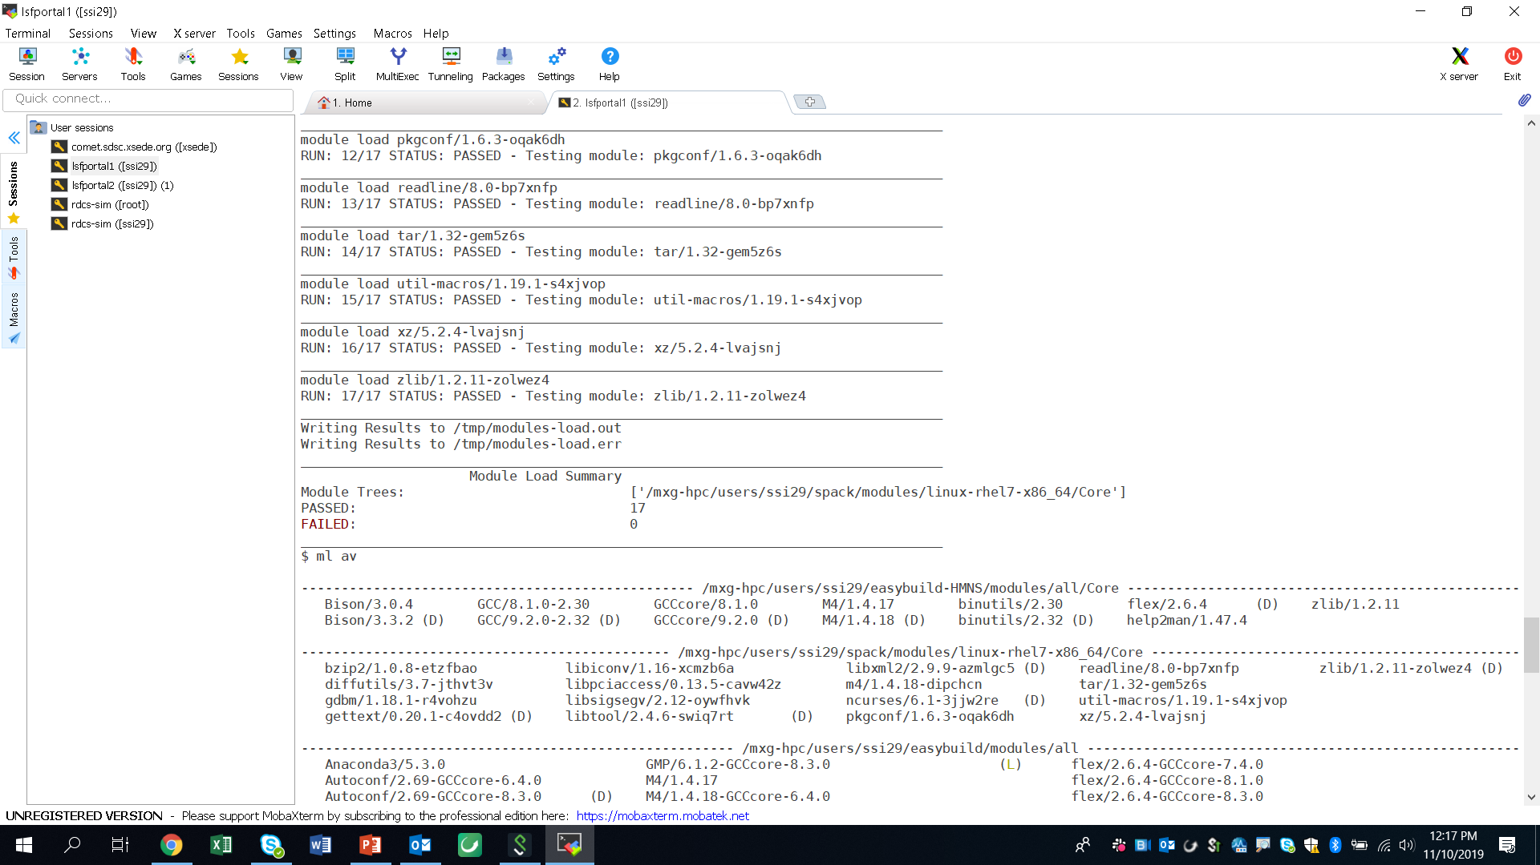
Module Load Testing
Problem: Verify all modules in a software stack

Slide 24
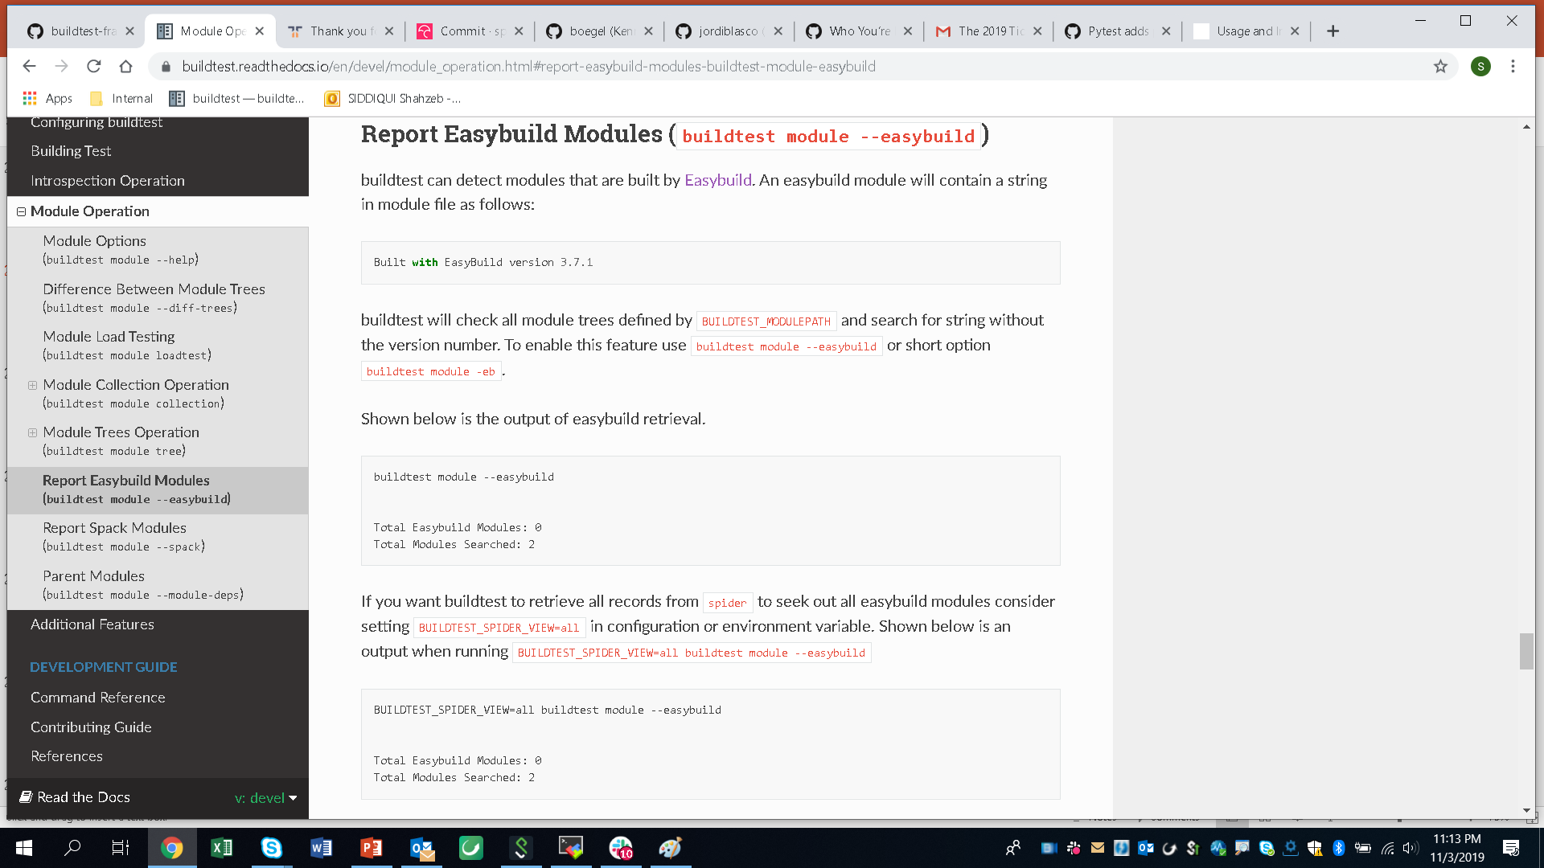
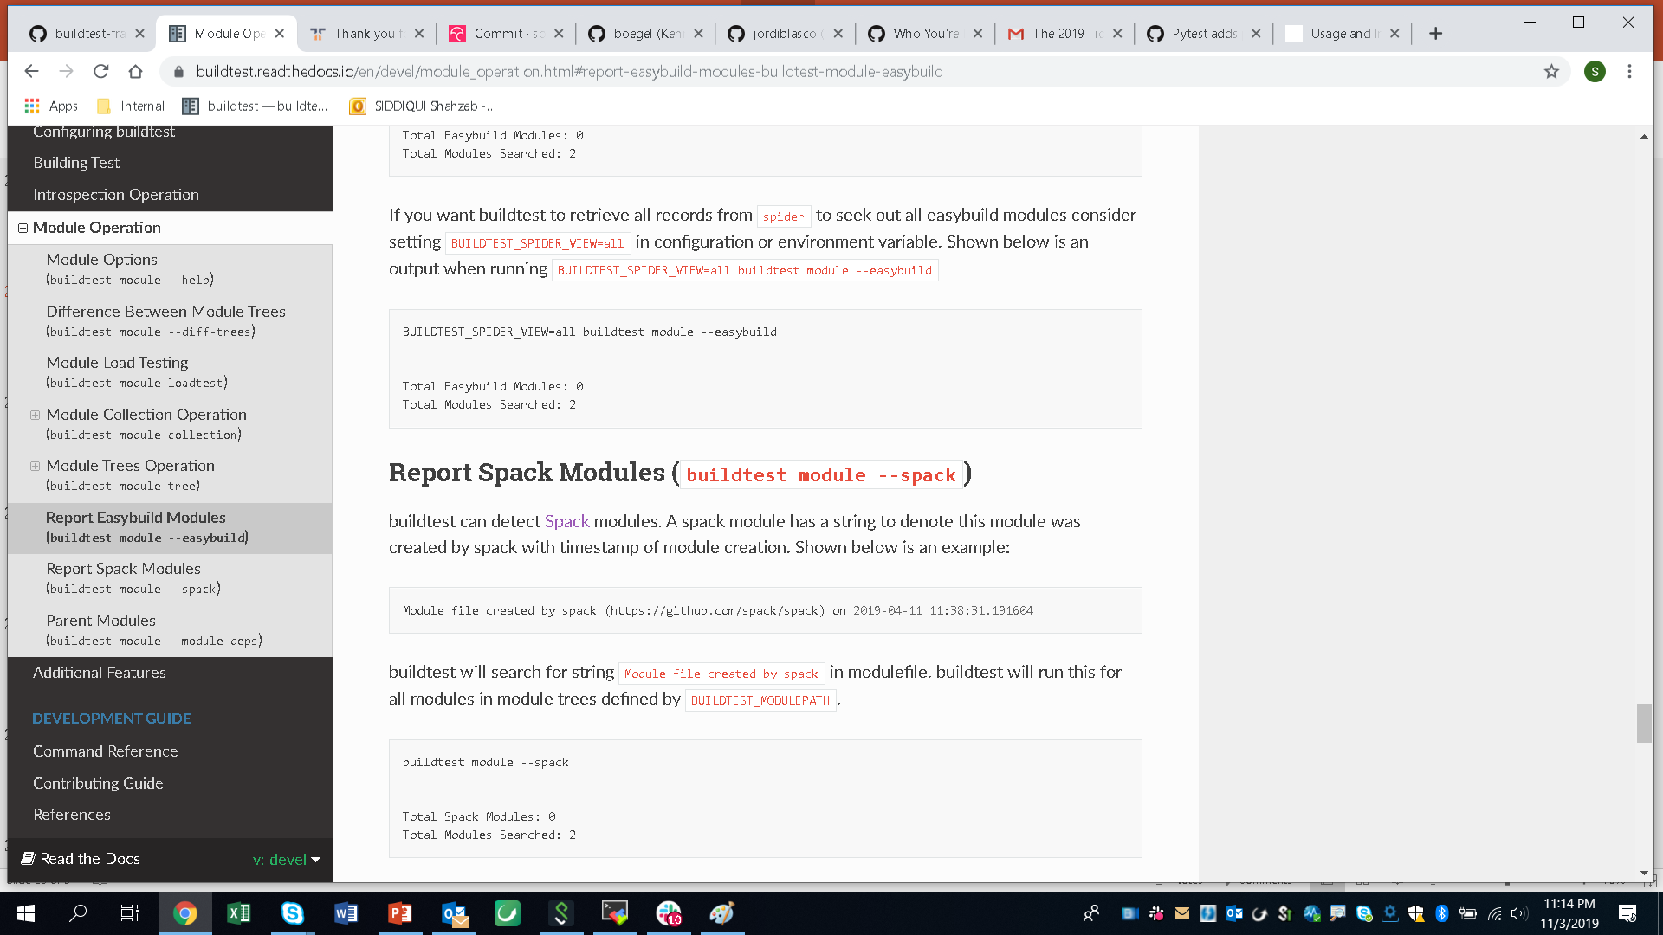
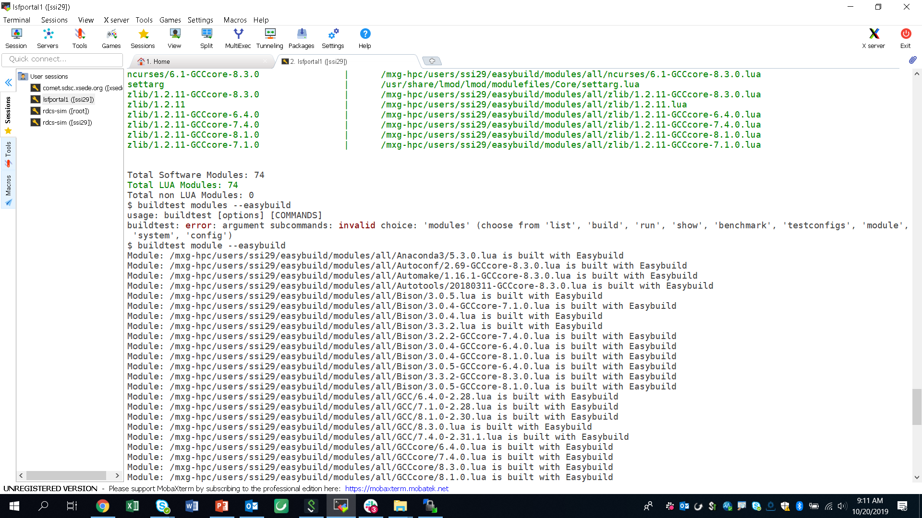
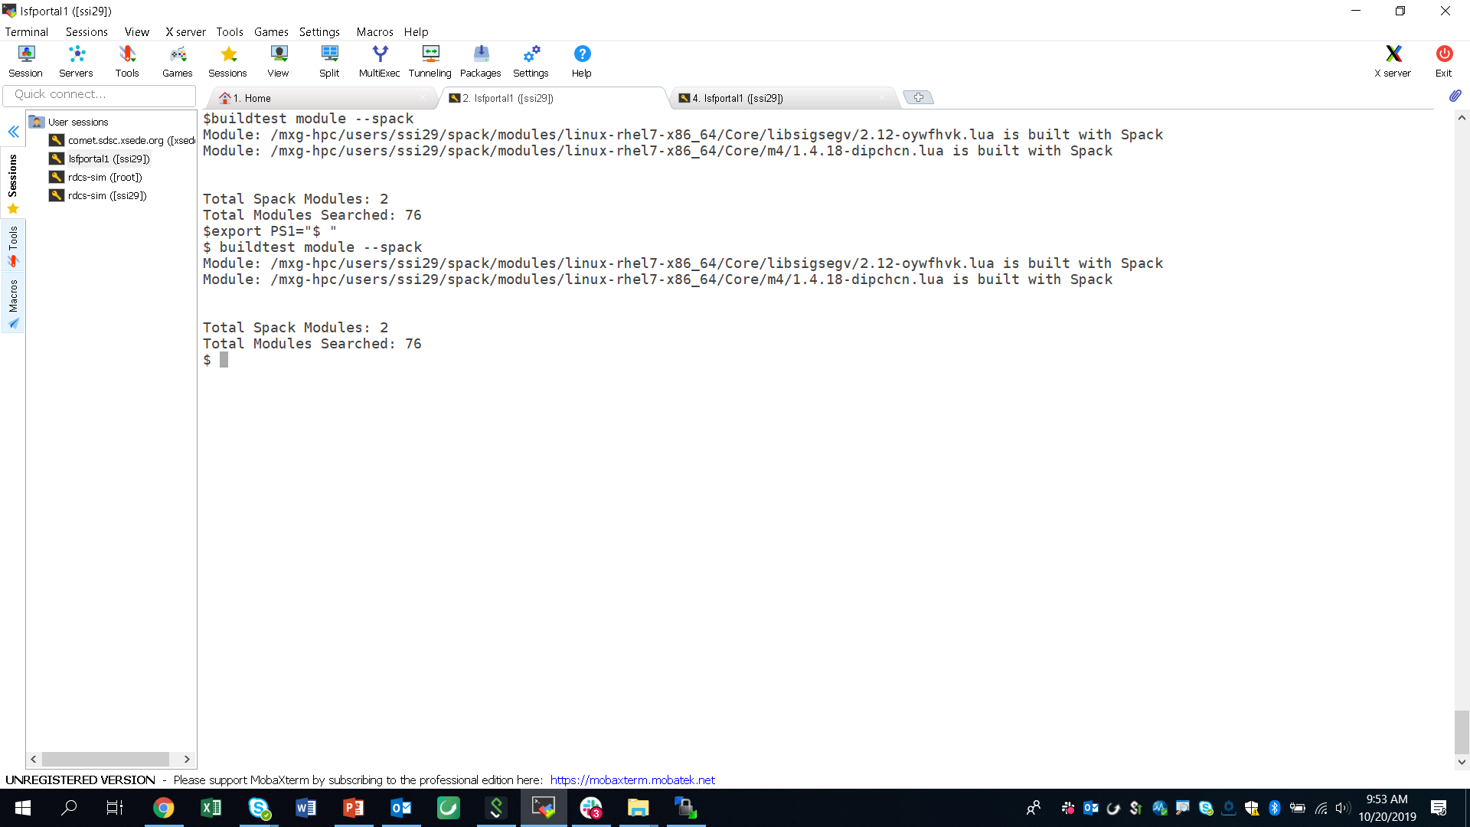
Reporting Easybuild & Spack Modules
Often times you want to know auto-generated modules (Easybuild, Spack) vs modules created manually.
This can be done by searching for a unique string in module file embedded by both package managers

Slide 25
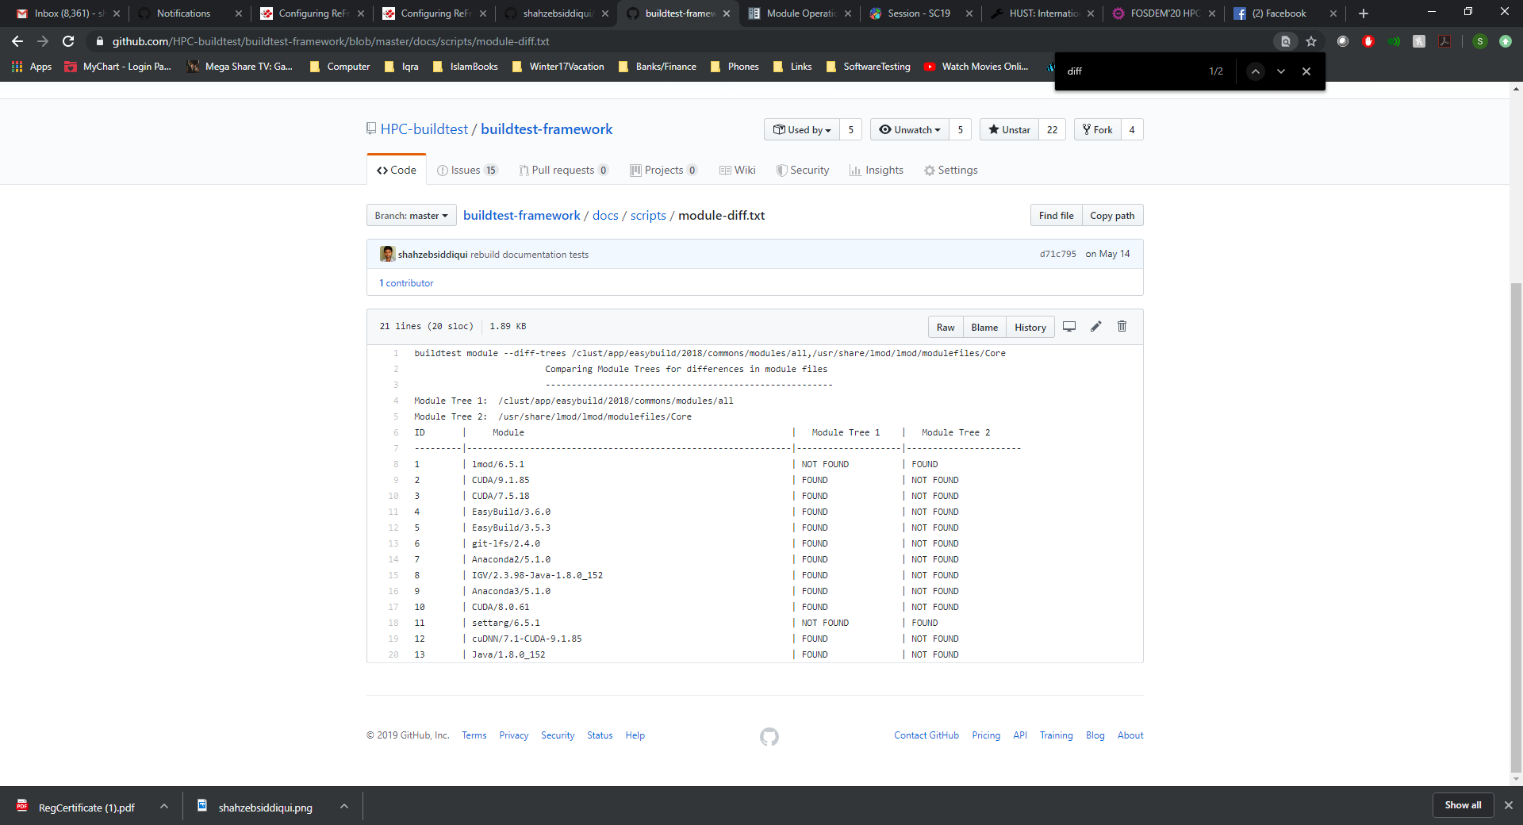
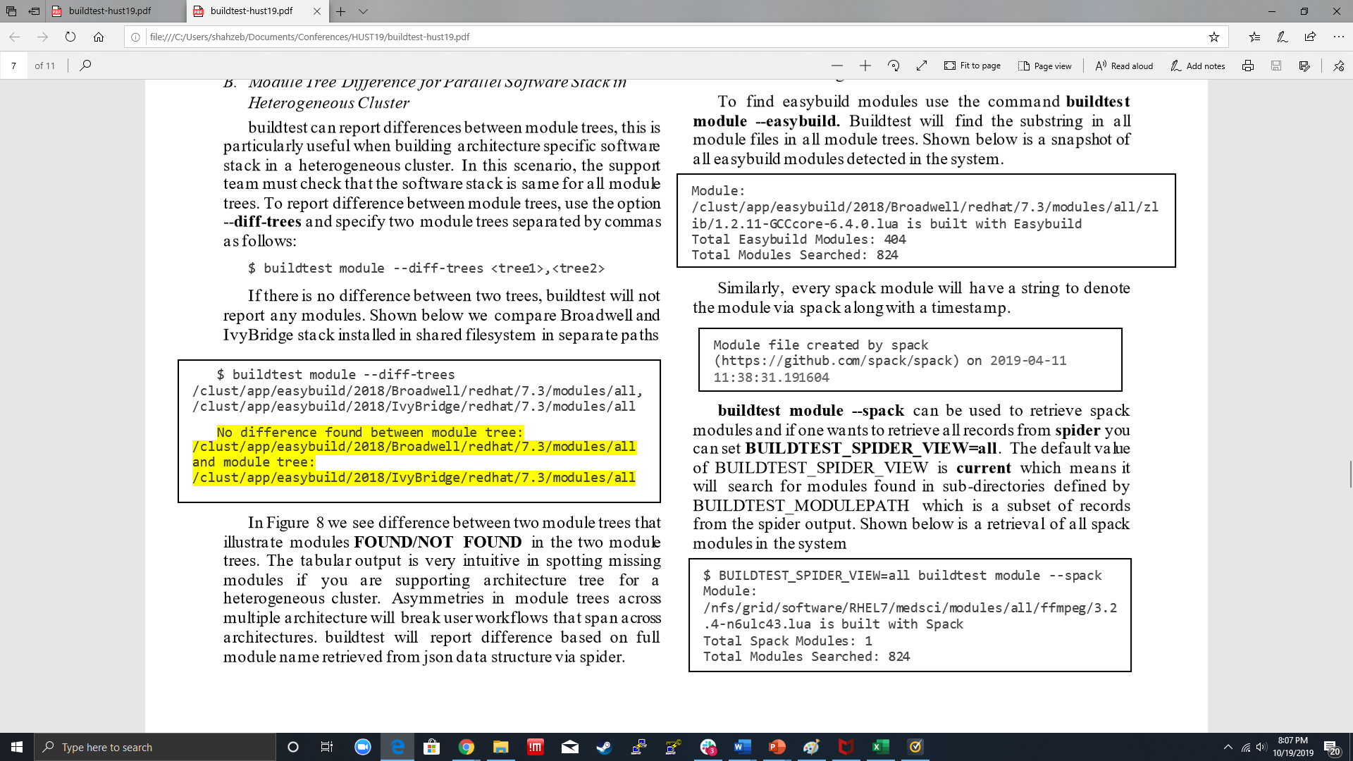
Difference between Module Trees
Problem: Building a Parallel Software Stack for each Architecture in a heterogeneous cluster and avoid asymmetries in modules between software stack.
Solution: Difference between two module trees by Module Full Name

Slide 26
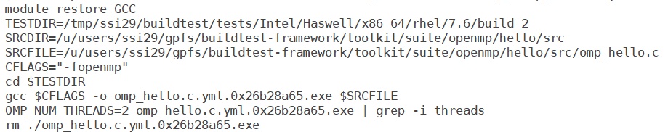
Building with Lmod User Collection
$ module list
Currently Loaded Modules:
1) GCCcore/8.3.0 2) zlib/1.2.11-GCCcore-8.3.0 3) binutils/2.32-GCCcore-8.3.0 4) GCC/8.3.0
Load the modules of interest
Save the modules in a user collection
Build the test by referencing the user collection
$ module save GCC
Saved current collection of modules to: "GCC"
$ buildtest build –c openmp.hello.omp_hello.c.yml –co GCC

Slide 27
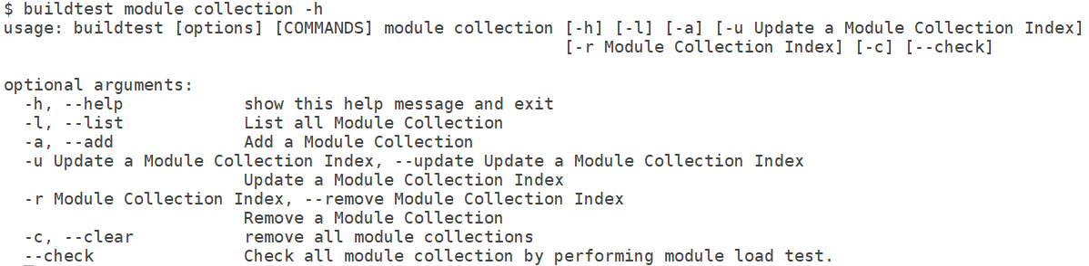
Buildtest Module Collection System
Lmod’s user collection must have unique collection name which is problematic when managing dozens of collections. Therefore, buildtest implements its own module collection system to store collections.
Module Collection Operations:

Slide 28
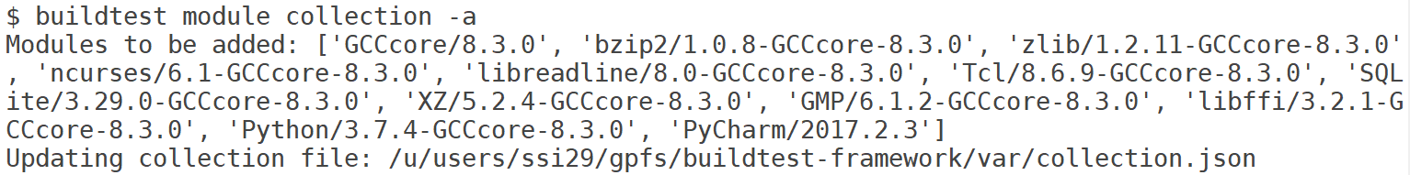
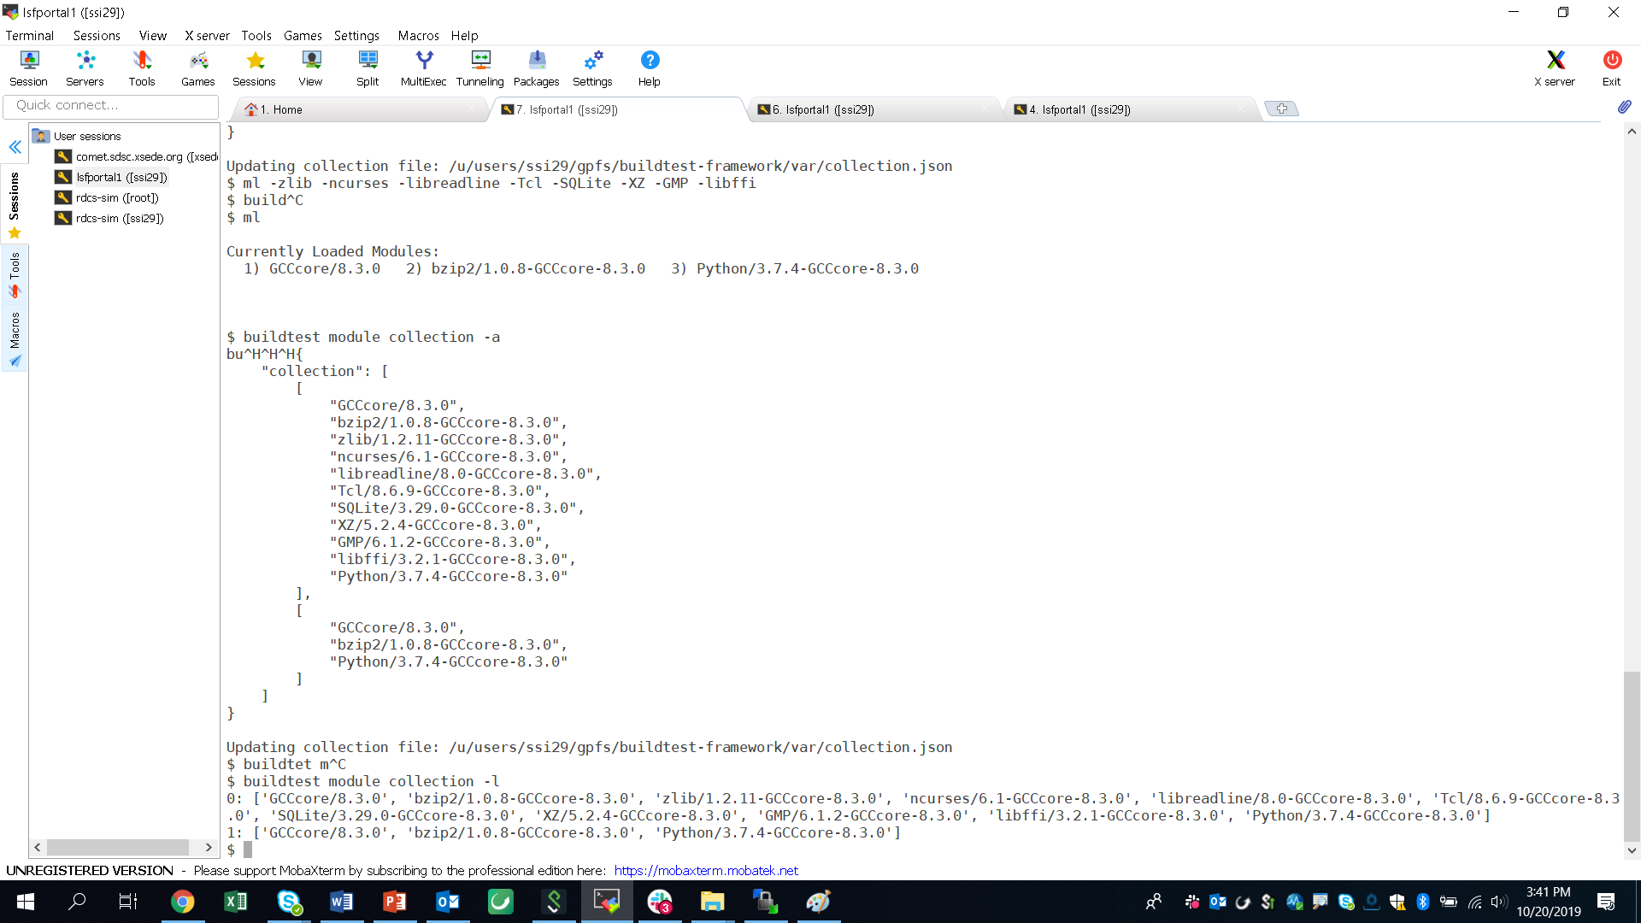
Module Collection Operations
Buildtest will store the module collection in collection.json that is self-maintained by buildtest
To add modules to a collection use buildtest module collection –a
Collection can be referenced by collection id (0, 1, 2, …)
To list all module collections use buildtest module collection –l

Slide 29
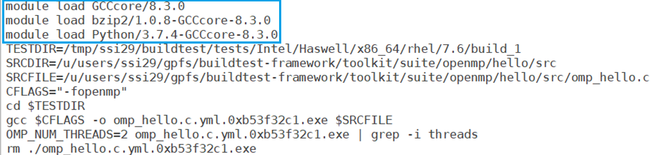
Building Test with Module Collection
To build a test with module collection use the –-module-collection option.
Let’s build a test with collection 0 as follows:
buildtest build –c openmp.hello.omp_hello.c.yml –-module-collection 0

Slide 30
Future Work
Extend MPI support to include: IntelMPI, MPICH, MVAPICH2
Extend compiler support to Intel, PGI, Clang.
Setup CI server to run regression test for buildtest on every commit/PR
Integrate CodeCov with CI build, codecov is already configured at https://codecov.io/gh/HPC-buildtest/buildtest-framework but coverage report are not automated
Extend testtype: singlesource to support scripting languages such as Python, Perl, Ruby, R

Slide 31
Conclusion
Buildtest is a framework that automates test creation through YAML configuration. Buildtest comes with a repository of test configuration and source files, however community contribution is required in order to build a test repository with useful tests that will benefit the entire community.
Software Stack Administrators can incorporate buildtest’s software stack operation in their daily operation when managing their software stack.
We need to build strong partnership in HPC community with respect to Software Stack Testing

Slide 32



What’s Next?
Clone, Star, and/or Fork buildtest and join the community on SLACK.
Contributing your Tests see: https://github.com/HPC-buildtest/buildtest-framework/blob/devel/toolkit/README.rst
Contributing Guide: https://github.com/HPC-buildtest/buildtest-framework
Report a Bug @ https://github.com/HPC-buildtest/buildtest-framework/issues
https://hpcbuildtest.slack.com/
https://hpcbuildtest.herokuapp.com/
https://github.com/HPC-buildtest/buildtest-framework

